Slide 1
Secure data hiding in images using stenography
CAPSTONE PROJECT
Presented By: Saurabh Rawat
Student Name: Saurabh Rawat
College Name & Department: Mewar Institute of Management, Computer Applications (BCA)

Slide 2
OUTLINE
Problem Statement
Technology used
Wow factor
End users
Result
Conclusion
Git-hub Link
Future scope

Slide 3
Problem Statement
Traditional encryption methods are vulnerable to detection, risking unauthorized access to sensitive data.
This project uses image-based steganography to hide messages within image pixels securely.
The embedded data remains inconspicuous, reducing the chance of interception.
A password-protected decryption ensures that only authorized users can retrieve the message.
This method offers a secure and efficient way to protect confidential communication.

Slide 4
Technology used
Programming Language:
Python
Libraries & Frameworks:
OpenCV (cv2): Used for image processing, reading, and writing image files.
os: For interacting with the operating system, such as opening the image after encryption.
Platforms:
Development Environment: Python IDE (e.g., Visual Studio Code, PyCharm)
Operating System: Windows (for executing the os.system command to open the image)
Image Format:
JPEG (.jpg) for storing the encrypted image

Slide 5
Wow factors
Image-based encryption hides messages in image pixels, making them hard to detect.
Password-protected decryption ensures secure access to the hidden message.
Invisible Data Concealment keeps the message undetectable in plain sight.
Dual Functionality integrates both encryption and decryption in one system.
OpenCV efficiently handles image manipulation with minimal distortion.

Slide 6
End users
Individuals: Anyone looking to securely communicate personal or confidential information.
Organizations: Businesses need secure internal communication for sensitive data.
Cybersecurity Enthusiasts: People interested in exploring innovative data protection methods.
Tech-Savvy Users: Users who want to protect data within images for privacy reasons.
Developers: Those implementing or experimenting with steganography and encryption techniques.

Slide 7
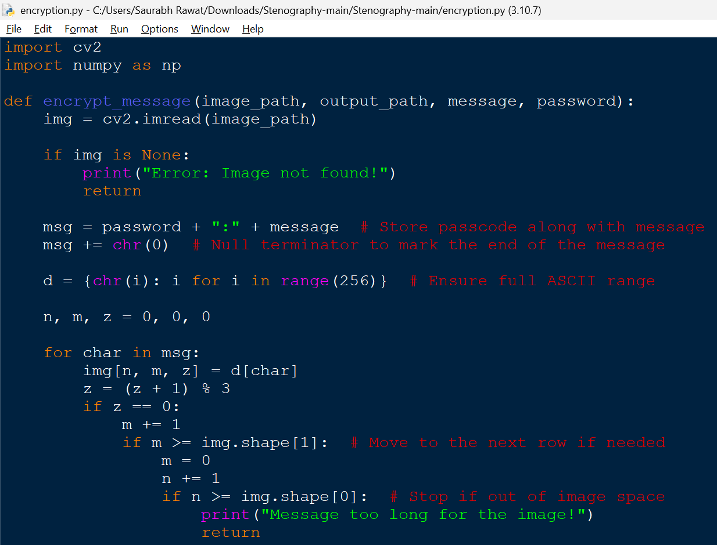
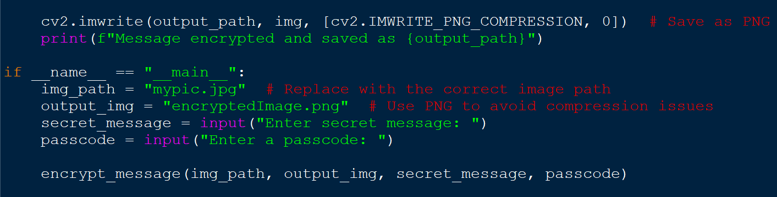
Results

Slide 8
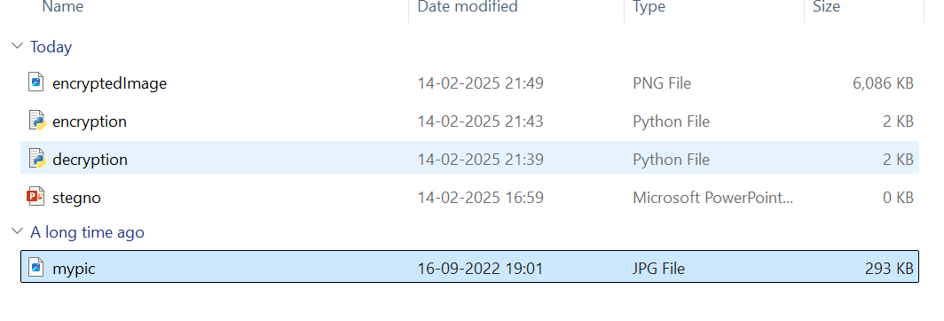
Results

Slide 9
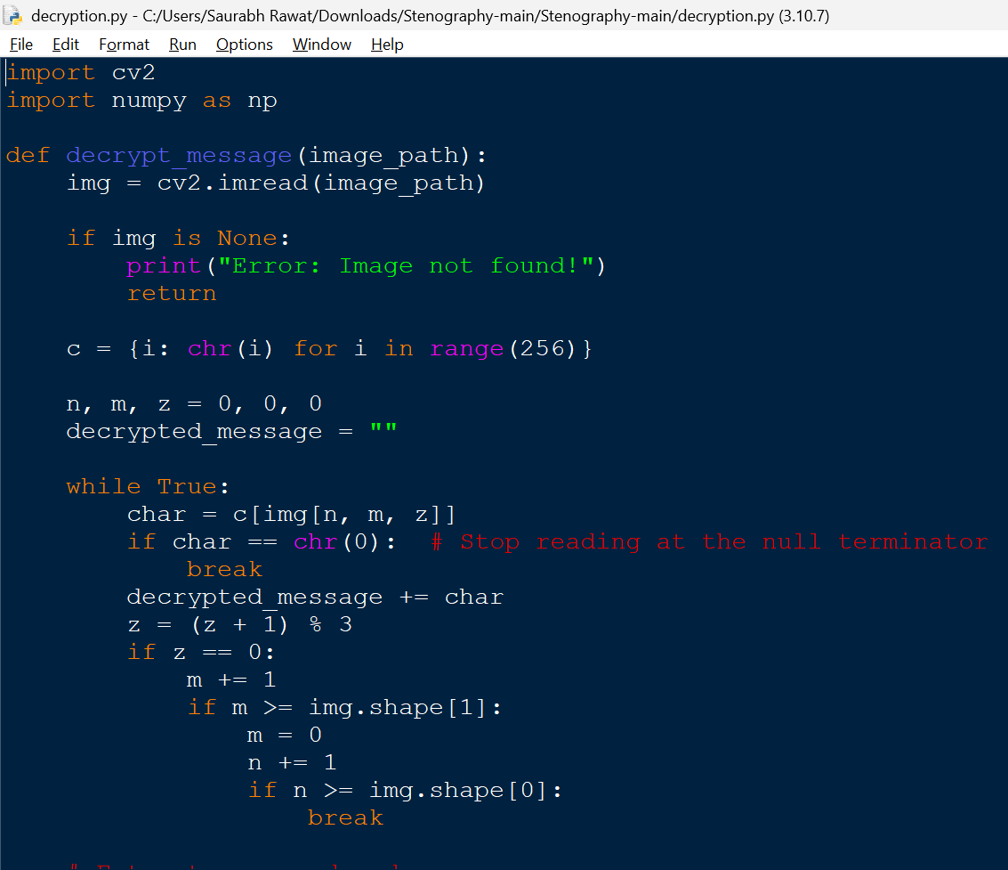
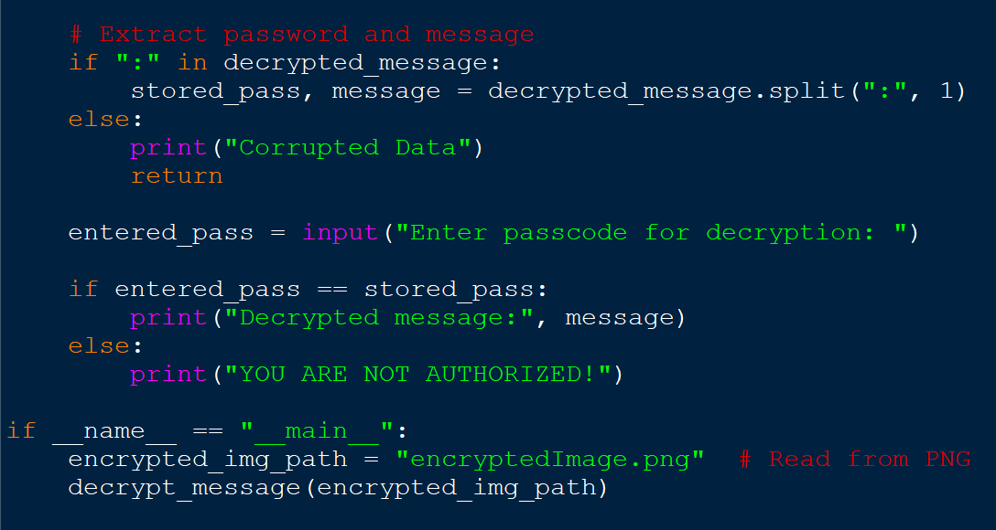
Results

Slide 10
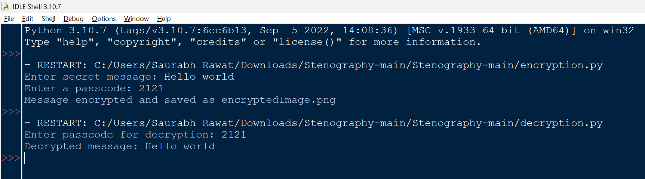
Results

Slide 11
Conclusion
This project successfully addresses the problem of secure data communication by utilizing image-based steganography to hide messages within image pixels. By combining encryption with password protection, the system ensures data remains inconspicuous and secure, minimizing the risk of unauthorized access. The use of OpenCV enhances the process, making the solution both efficient and effective in providing confidential communication in a modern digital world.

Slide 12
GitHub Link
Project GitHub Repository You can access the project code on GitHub:
View Source Code

Slide 13
Future scope(optional)
Improved Encryption Algorithms: Integrating more advanced encryption techniques for enhanced security.
Support for Other File Formats: Expanding the project to support hiding messages in various file formats like audio or video.
Real-Time Messaging: Implementing real-time message encryption for secure instant communication.
AI Integration: Using AI to detect and prevent potential vulnerabilities in the encryption process.
Mobile App Integration: Developing a mobile application for easier access and usage of the encryption system on smartphones.

Slide 14
THANK YOU

